Slide 1
Malignant Comments Classification
Submitted By- ANURAG KUMAR

Slide 2
PROBLEM STATEMENT
Classify malignant comments.
Clean Data Set
Make prediction model on train test set.
Predict comment classification on test data set.

Slide 3
Data Description
Data contain two csv file- a) Train Data set b)Test Data set
Training data set have 8 columns including id, comment and comments classification.
Test data set contains two columns, id and comment.
Comment data set is text data which required pre-processing.

Slide 4
Comment Column preprocessing Approach
Convert all messages to lower case
Replace email addresses with 'email’
Replace URLs with ‘webaddress’
Replace money symbols with 'moneysymb'
Replace 10 digit phone numbers (formats include parenthesis, spaces, no spaces, dashes) with 'phonenumber’
Replace numbers with 'numbr’
Remove punctuations
Remove stop words
Word Lemmatize.

Slide 5
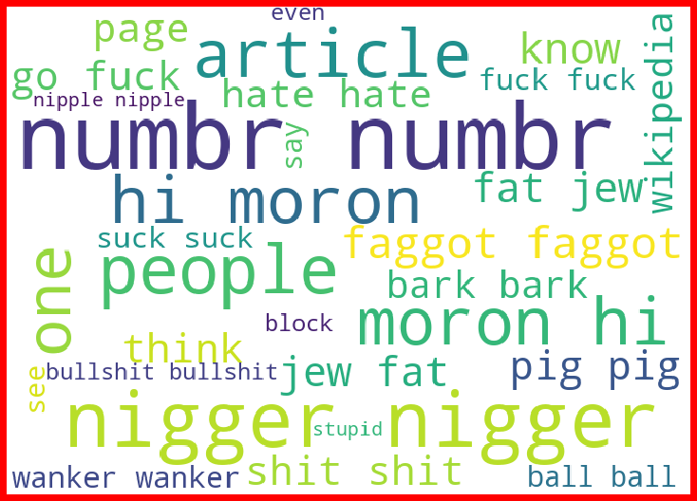
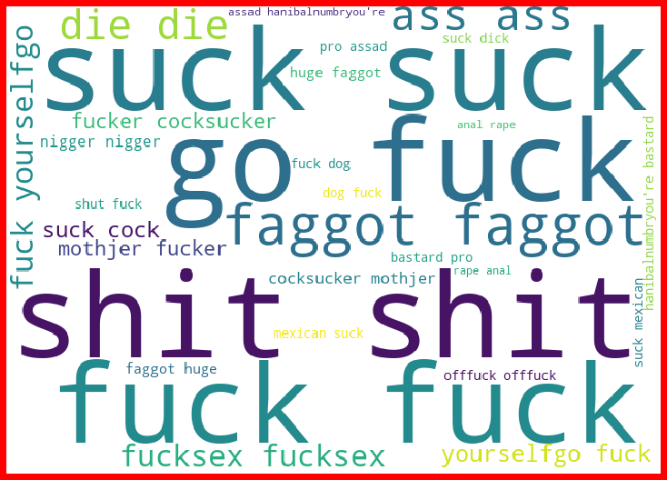
Data Visualization- Wordnet (Malignant Comment)

Slide 6
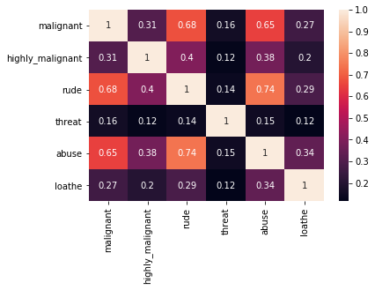
Correlation Matrix

Slide 7
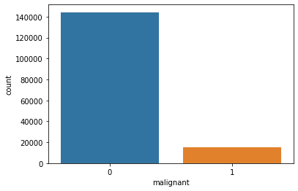
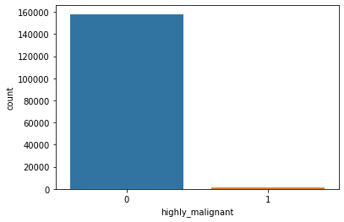
Count plot Malignant and Highly Malignant

Slide 8
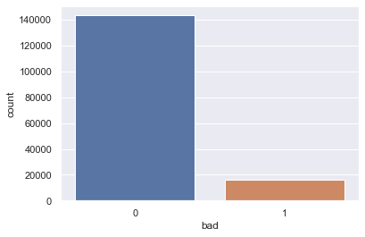
Characterization of Malignant(0) and Non- Malignant (1)

Slide 9
Different Classification Model
Model | Train Accuracy | Test Accuracy
Logistic Regression | 93.76 | 92.866
Decision Tree | 99.79 | 93.83
Random Forest Classifier | 99.79 | 97.58

Slide 10
Confusion Matrix & Classification Report
precision recall f1-score support
0 0.99 0.96 0.98 43173
1 0.96 0.99 0.98 42835
accuracy 0.98 86008
macro avg 0.98 0.98 0.98 86008
weighted avg 0.98 0.98 0.98 86008
[[41549 1624]
[ 451 42384]]

Slide 11
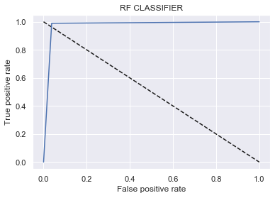
ROC- CURVE

Slide 12
Conclusion
Attained 97% accuracy in test dataset.
Roc curve shows maximum area are under the curve.
Model predicted following results- 1- 77850, 0-75314

